Slide 1
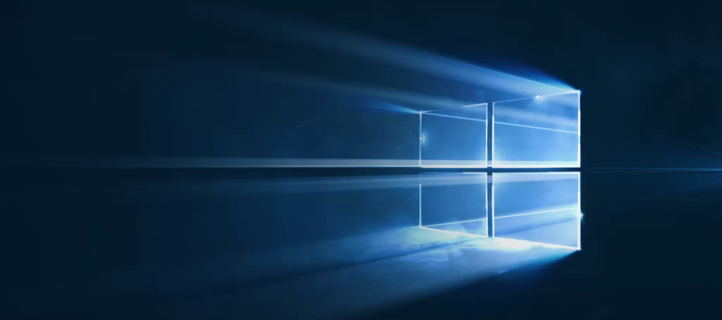
Windows
Camp //Labs
2015

Slide 2




Windows Camp //Labs
#wincamplabs

Slide 3
Более персонализированные приложения
06b
Никола Метулев
Технологический евангелист, Microsoft

Slide 4
What are App Services?
Notes:
App Services is a new feature in Windows 10 UWP that offers an interesting and useful way for apps to interact with each other.

Slide 5
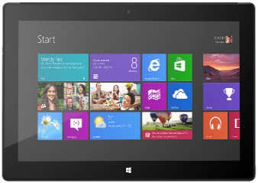
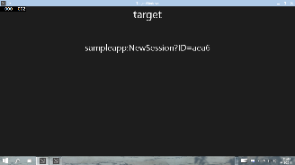




App Service: Special case of Background Task
Client App A
App with App Service
Background Task
Client App B
Notes:
App Services is a way for store applications to publish a services endpoint (i.e. an API) locally on a device that clients can call to achieve some task. Other store applications can then call these services to help users perform tasks that would otherwise require the user to go in and out of multiple applications.

Slide 6

Scenario: Bar Code Scanning
Bar Code decoding App Service
Image bytes in ValueSet or FileToken
Decoded data
Notes:
One example might be a service offering barcode decoding services. Clients can simply capture an image of the barcode, send the captured bytes to an app service and receive back the decoded result. In this way apps can easily add barcode decoding without having to directly implement that capability, or duplicate the same or similar functionality across a number of apps.

Slide 7


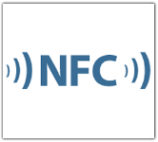
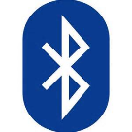
Scenario: Enterprise suite of apps
Client App A
App Service
Maintains Inventory cache
Interact with cloud services
Client App B
App Service
Proximity Reading Services
Notes:
In scenarios where the apps talking to each other are known to each other these features can be used to drive complex user tasks that span across multiple apps. For example, the ability to invoke a particular app and get return values from the invocation – whether that’s foreground apps using LaunchForResults or background tasks using App Services - could be used to drive an SSO mechanism. Another example is an enterprise or publisher with a suite of apps each of which provides a subset of the functionality a user might use while performing their day to day tasks. The suite of apps scenario in particular is very common across our enterprise customers .

Slide 8
Think of App Services as ‘Web services on device’
Notes:
One way of thinking of App Services is that they are like REST Web services, but installed locally onto a device.
One difference is that App Services are message-based application services, unlike web services which are HTTP-based.

Slide 9
App Services – Client
AppServiceConnection connection = new AppServiceConnection(); connection.AppServiceName = "microsoftDX-appservicesdemo"; connection.PackageFamilyName = "24919ArunjeetSingh.InstapaperIt"; AppServiceConnectionStatus connectionStatus = await connection.OpenAsync(); if (connectionStatus == AppServiceConnectionStatus.Success) { //Send data to the service var message = new ValueSet(); message.Add("Command", "CalcSum"); message.Add("Value1", Int32.Parse(Value1.Text)); message.Add("Value2", Int32.Parse(Value2.Text)); //Send message and wait for response AppServiceResponse response = await connection.SendMessageAsync(message); if (response.Status == AppServiceResponseStatus.Success) { int sum = (int)response.Message["Result"]; new MessageDialog("Result=" + sum).ShowAsync(); } }
Notes:
The client creates an AppServiceConnection and then calls the SendMessageAsync API to send a message (a ValueSet) and (optionally) receive a response (also a ValueSet).

Slide 10
App Services – Service (1/2)
namespace AppServicesDemoTask { public sealed class AppServiceTask : IBackgroundTask { private static BackgroundTaskDeferral _serviceDeferral; public void Run(IBackgroundTaskInstance taskInstance) { var appService = taskInstance.TriggerDetails as AppServiceTriggerDetails; if (appService.Name == "microsoftDX-appservicesdemo") { // Hook up the RequestReceived event handler appService.AppServiceConnection.RequestReceived += RequestReceived; } } ...
Notes:
The service also gets an AppServiceConnection when it is Run. It uses this RequestReceived event on the AppServiceConnection to listen for incoming messages.

Slide 11
App Services – Service (2/2)
private async void RequestReceived(AppServiceConnection sender, AppServiceRequestReceivedEventArgs args) { var message = args.Request.Message; // This service uses a Command keyed entry for the client to invoke services from the App Service string command = message["Command"] as string; switch (command) { case "DoIt": { var messageDeferral = args.GetDeferral(); int value1 = (int)message["Value1"]; ... Do some processing //Set a result to return to the caller var returnMessage = new ValueSet(); returnMessage.Add("Result", result); var responseStatus = await args.Request.SendResponseAsync(returnMessage); messageDeferral.Complete(); break; } ... } }
Notes:
It uses this RequestReceived event handler to respond to incoming messages.
The wonderful thing is that the connection is two-way. The Client could also listen for messages by using the AppServiceConnection it set up. The AppService lives for as long as the client is alive. There are no lifetime limits to the app service itself.
Some other points to consider:
If the client wants to stop the application service it can dispose the AppServiceConnection reference it has.
Calling AppServiceRequestReceivedEventArgs.Request.SetResponseAsync is optional. An app service endpoint does not HAVE to return a response.

Slide 12
Declaring App Service
<?xml version="1.0" encoding="utf-8"?> <Package xmlns="http://schemas.microsoft.com/appx/manifest/foundation/windows10" ... >
<Applications> <Application Id="App“ ... > <Extensions> <uap:Extension Category="windows.appService“ EntryPoint="AppServicesDemoTask.AppServiceTask"> <uap:AppService Name="microsoftDX-appservicesdemo" /> </uap:Extension> </Extensions> </Application> </Applications> <Capabilities> <Capability Name="internetClient" /> </Capabilities> </Package>
Notes:
The app that hosts the background task where the app service is implemented is a regular foreground app. It has one very important task: it is in the Package manifest for this app that you must declare the App Service.
You must declare the entrypoint, which is the Namespace and class of the background task that implements the App Service, and you must declare the name of the App Service. The client app has to specify this App service name when creating a connection.
The hosting foreground app itself has no influence on the operation of the App Service. Usually, you would implement some app that itself is a client of the App Service, but there is no requirement for that.

Slide 13
Two-way Communication
Client and server can keep a two-way chatty communication channel open
Client can attach a RequestReceived event handler to its own AppServiceConnection instance
Both client and server can send and receive messages
AppServiceConnectionStatus connectionStatus = await connection.OpenAsync(); if (connectionStatus == AppServiceConnectionStatus.Success) { connection.RequestReceived += OnRequestReceived; }
Notes:
The fact that the client has control over the lifetime of the application service and can keep a chatty communication channel open with it is a key differentiator for message-based application services over Http-based services. Also important is the fact that message-based services allow for exchange of arbitrary byte buffers embedded in the ValueSet messages exchanged between client and service.

Slide 14
Lab: App Services

